Slide 1

How has AI development influenced the job market for recent graduates?
YJ
10/2025

Slide 2

Outline
Executive Summary
Introduction
Methodology
Results
Visualisation – Charts
Dashboard
Discussion
Findings & Implications
Conclusion
Appendix

Slide 3

EXECUTIVE SUMMARY
This reports analyses employment trends under the context of rapid AI development to understand patterns of job postings, career progression in terms of salaries and required skills for data-related roles.
The analysis found that AI development has increased the demand for jobs in data infrastructure, data analysis, data science and data management and security. Other entry-level jobs are also directly disrupted by AI, or require augmentation and skill shift. For better career progression, AI-resistant skills such as communication, problem-solving, analytical thinking, and adaptability are high valued by employers.
For students who want to enter a data-related career, they should develop proficiencies in mostly used programming languages, cloud platforms, and databases.

Slide 4

INTRODUCTION
With the rapid development of AI and increasing investment in data centres, the AI technology has influenced the job market. While AI technology leads to the creation of data-related jobs, it can also replace the work, such as customer services, underwriters, junior lawyers and so on.
Hence, it is essential for job-seekers, especially university students or recent graduates to understand the potential opportunities in recent job markets and career progression.
This analysis uses job postings scraped from various platforms such as LinkedIn, Indeed and etc. for 2024 and 2025 (April to June).
The main findings:
AI development has led to growing demand in date-related jobs.
Developing AI-resistant skills offer sustainable career opportunities, such as communication, problem-solving, analytical thinking, and adaptability.
For data-related jobs, students should prioritise in developing technical proficiencies in SQL and Python (the most in-demand programming languages), cloud platforms like Azure and AWS, and a mix of relational (MySQL, PostgreSQL, Oracle) and non-relational (MongoDB) databases.

Slide 5

METHODOLOGY
Data sources: Job postings data from Kaggle and Hugging Face.
Collection method: The postings data are already web-scraped and saved in the Hugging Face and Kaggle. Job recruitment websites include LinkedIn, Indeed, Glassdoor and etc.
Data wrangling for this datasets includes importing into Databricks, running SQL to clean the jobs descriptions, posting date and grouping jobs into four main categories: data-related, augmentation and skill shit, directly disrupted and other.
Data visualisation includes a stacked bar chart showing the number of posting by category, pie charts showing the specific postings within the categories, annual average salaries for jobs postings, and the mostly required skills from data-related job descriptions.

Slide 6
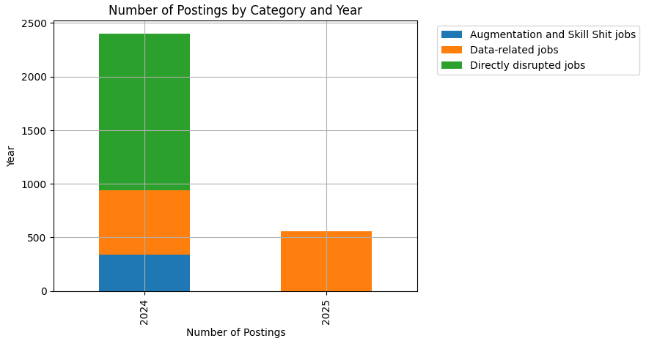
AN OVERVIEW OF JOB POSTINGS

Slide 7
AI IS RESHAPING THE JOB MARKET, DEVELOPING REQUIRED SKILLS OR UPSKILLING AND TRANSITIONING IS IMPORTANT.
The job categories are defined based on how jobs are affected by AI.
Data-related: AI leads to the creation and rise in demand for jobs in data infrastructure, data analysis, data science and data management and security.
Directly-disrupted: these jobs can be replaced by AI – data entry, bookkeeping and accounting clerk and basic customer service.
Augmentation and skill shift: tasks in these job can be done by AI – financial and insurance underwriter, entry-level lawyers, solicitors and HR recruiters.
Since the 2025 dataset only covers job postings from April to June and excludes roles negatively affected by AI, a full year-on-year comparison cannot be made for all categories. Therefore, only data-related jobs, which appear in both years, allow for meaningful comparison.
In 2024, the majority of job postings fell under the directly disrupted category, followed by data-related and augmentation and skill-shift roles.
In 2025, data-related jobs might actually increased. Only within two months, the number of postings is similar to the whole year in 2024.
Implications:
AI is both reshaping and redefining employment.
Jobs which are directly disrupted were still in demand despite being risk of automation.
The smaller share of augmentation and skill-shift indicated the transformation of professional roles.
Data-related roles has been continuously growing, indicating the increasing dependence of organisations on data expertise, even as automation reduces opportunities in other job categories.
For university students and recent graduates, developing skills in data analysis, programming, and AI integration will provide stronger career prospects. In contrast, workers in routine or administrative roles may need to upskill or transition toward data- and technology-related fields to remain competitive in the evolving job market.

Slide 8
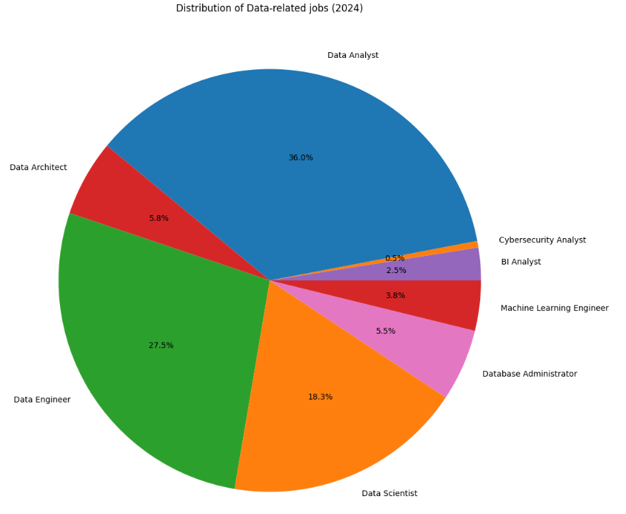
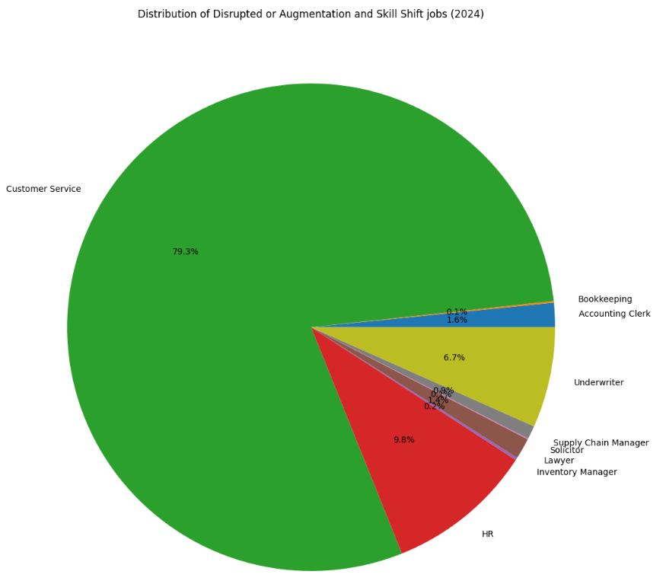
POSTINGS IN DATA-RELATED AND AI-DISRUPTED JOBS (2024)

Slide 9
AI IS RESHAPING THE JOB MARKET, DEVELOPING REQUIRED SKILLS OR UPSKILLING AND TRANSITIONING IS IMPORTANT.
The two charts illustrate the distribution of job postings in 2024, divided into data-related jobs and disrupted or augmentation/skill-shift jobs, based on how they are affected by AI.
Most postings were for Data Analysts (36%) and Data Engineers (27.5%). Data Scientists (18.3%) also made up a notable share, indicating growing reliance on advanced analytics. Other roles, such as Database Administrators, Data Architects, and Machine Learning Engineers, appeared less frequently but signal steady expansion in technical data infrastructure and AI development.
Among roles most influenced by AI, Customer Service (79.3%) dominated, highlighting the high potential for automation. Smaller shares of HR (9.8%) and Underwriters (6.7%) suggest partial automation rather than full replacement, while roles like Bookkeeping and Legal positions appeared minimally, indicating that automation and AI-assisted tools may already be reducing recruitment needs in these areas.
Implications:
There is strong and growing need for roles that manage, process, and interpret large datasets. Companies had also increased reliance on advanced analytics and predictive modelling.
There were also ongoing but smaller-scale needs for data infrastructure management and highly technical or AI-specialist positions.
AI chatbots and virtual assistants has been widely adopted, and AI has been increasing supporting decision-making and repetitive tasks. However, human expertise remains essential in HR roles and Underwriters.
For university students and graduates, this indicates that students with STEM-related degrees can consider data-related jobs. For other degrees such as humanities and social sciences, students should be aware of the AI adoption in the career they are interested in, and prepare for upskilling or transitioning their skills.

Slide 10
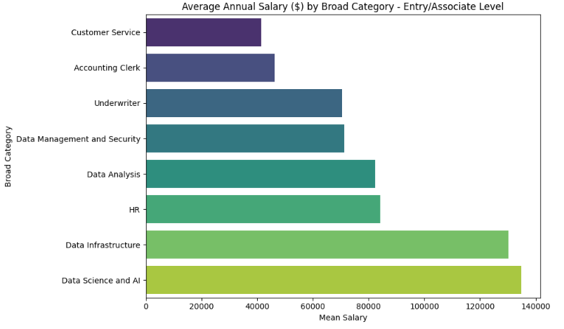
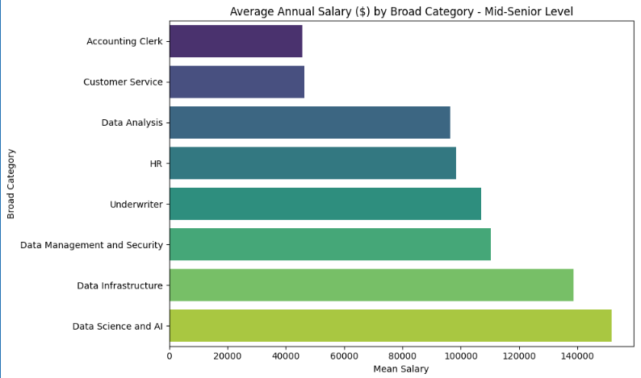
ANNUAL SALARIES FOR DATA-RELATED AND AI-DISRUPTED JOBS BY EXPERIECE LEVEL.

Slide 11
SALARY TRENDS SHOW STRONG GROWTH IN AI-RESISTANT CAREERS
The bar charts illustrates the mean annual salaries for entry and mid-senior level for data-related and AI-disrupted jobs.
Overall, data-related positions experience the strongest salary growth, reflecting the high value of technical expertise. Salaries in data-focused roles rise notably from Entry/Associate to Mid-Senior levels. Data Management and Security shows the largest gain, climbing from $75K to around $110K. Data Analysis sees pay jump from $80K to $95K. Data Science and AI increase from about $130K to over $140K, while Data Infrastructure grows from $125K to nearly $130K.
AI-disrupted roles also see upward movement. Underwriters’ pay grows from $70K to $105K, and HR salaries rise from $85K to $110K. In contrast, Accounting Clerks and Customer Service roles show smaller increases—from $50K to $55K and $40K to $55K, respectively.
Implications:
For university students and recent graduates, they should choose career based on the entry-level salaries and further career progression, especially those with skills which cannot by replaced by AI.
Data Science, AI, and Data Management: not only start with high entry-level salaries but also show the steepest growth as professionals gain experience.
HR and Underwriting: solid career progression, although tasks at entry-level can be disrupted by AI.
Accounting and Customer Service: slower salary growth, suggesting more limited financial returns over time.

Slide 12
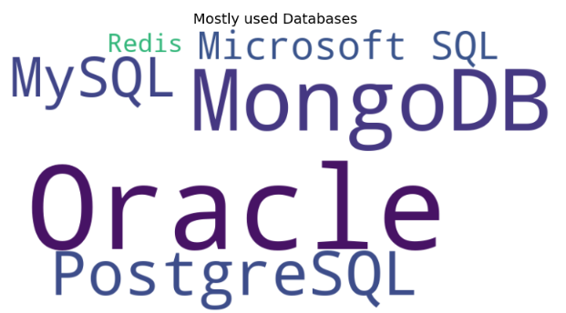
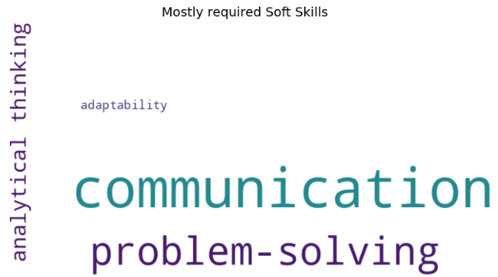
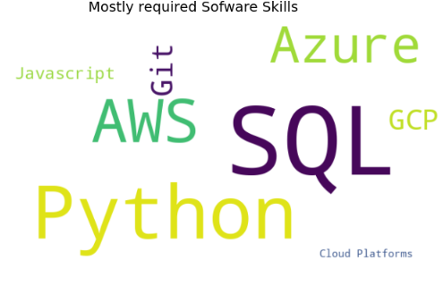
MOST REQUIRED SKILLS IN DATA-RELATED JOBS

Slide 13
MOST REQUIRED SKILLS IN DATA-RELATED JOBS
For data-related jobs, the most frequently required programming languages are SQL and Python, while the most commonly requested cloud platforms are Azure, AWS, and Git. JavaScript is also required, particularly for certain data analysis or data engineering positions.
The most commonly used databases include Oracle, MongoDB, and other SQL-based systems such as MySQL, PostgreSQL, and Microsoft SQL Server.
In terms of soft skills, communication and problem-solving are universally important. Analytical and critical thinking are especially emphasized in data analysis and data science roles. Adaptability reflects the expectation for professionals to continuously learn new technologies and skills within the industry.
Implications:
With the requirement in cloud platforms, this implies that data field has been shifting towards scalable, collaborative, and agile workflows.
For university students and graduates considering a data career path, this suggests that prioritising in developing technical proficiencies in SQL and Python (the most in-demand programming languages), cloud platforms like Azure and AWS, and a mix of relational (MySQL, PostgreSQL, Oracle) and non-relational (MongoDB) databases.
Additionally, investing in soft skills such as communication, problem-solving, analytical thinking, and adaptability are critical for translating data insights to stakeholders and thriving in a rapidly evolving industry.

Slide 14
CONCLUSION
Overall, the analysis reveals that, while AI has increased the demand for analytical and technical expertise, many entry-level jobs might be replaced.
There is a clear divide in salary progression between AI-resistant and AI –replacement jobs.
Positions in Data Science, AI, and Data Management not only begin with higher starting salaries but also demonstrate stronger growth into senior levels.
HR and Underwriting start with lower entry level salaries and with pay rise in mid-senior level with AI-resistant skills.
Accounting and Customer Service show more modest salary development, indicating slower financial advancement over time.
These patterns suggest that as technology continues to shape the job market, investing in data-driven skills offers graduates the better short- and long-term career growth and competitive earnings.

Slide 15
APPENDIX
The first one is a dashboard, including the pie charts for job categories and the annual salaries.
The second one shows the correlation between jobs postings and the number of views or applies made to each posting, by experience level.

Slide 16
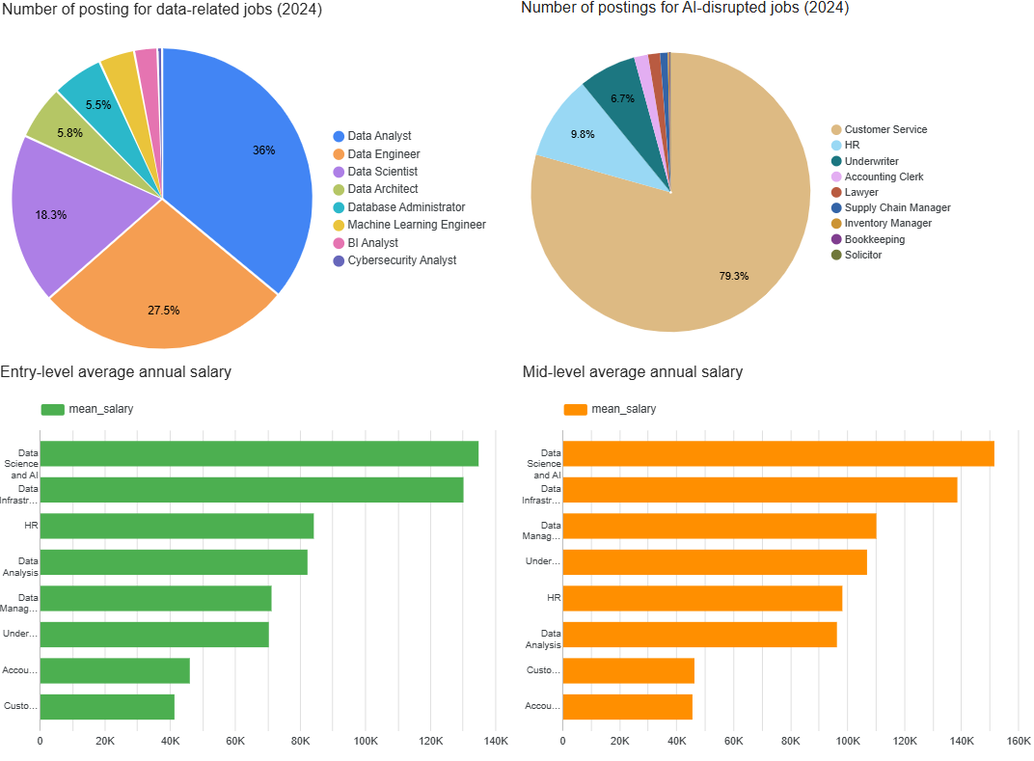
APPENDIX

Slide 17
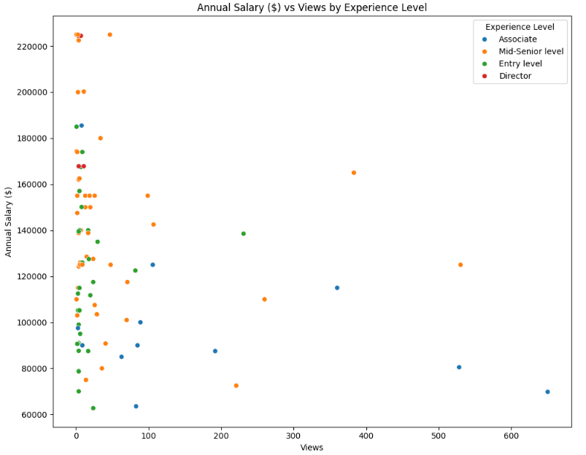
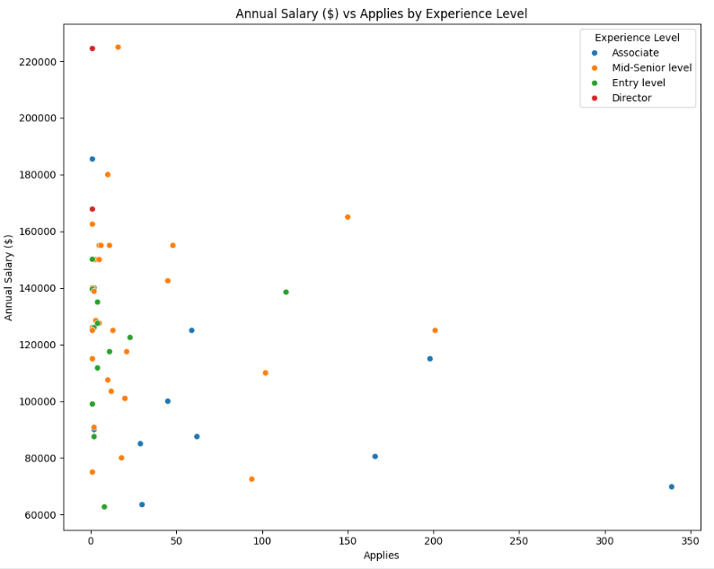
APPENDIX

